Slide 1
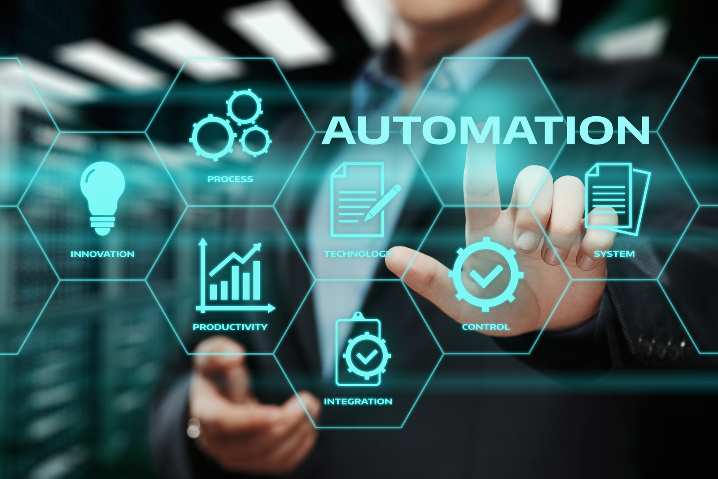
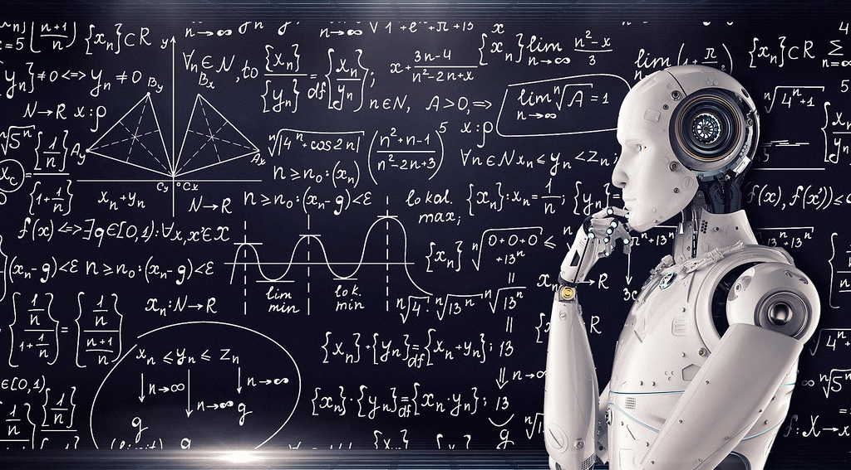
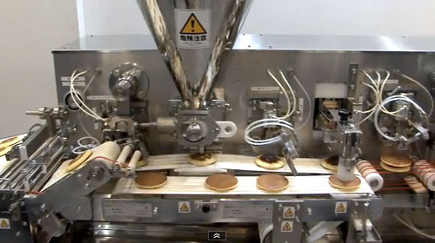


BUSINESS CASE ANALYSIS
This Photo by Unknown Author is licensed under CC BY-SA-NC
This Photo by Unknown Author is licensed under CC BY-NC-ND
This Photo by Unknown Author is licensed under CC BY-NC-ND
This Photo by Unknown Author is licensed under CC BY
This Photo by Unknown Author is licensed under CC BY-SA
This Photo by Unknown Author is licensed under CC BY-SA-NC

Slide 2

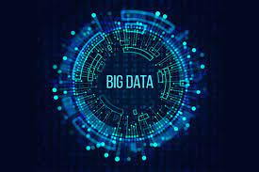
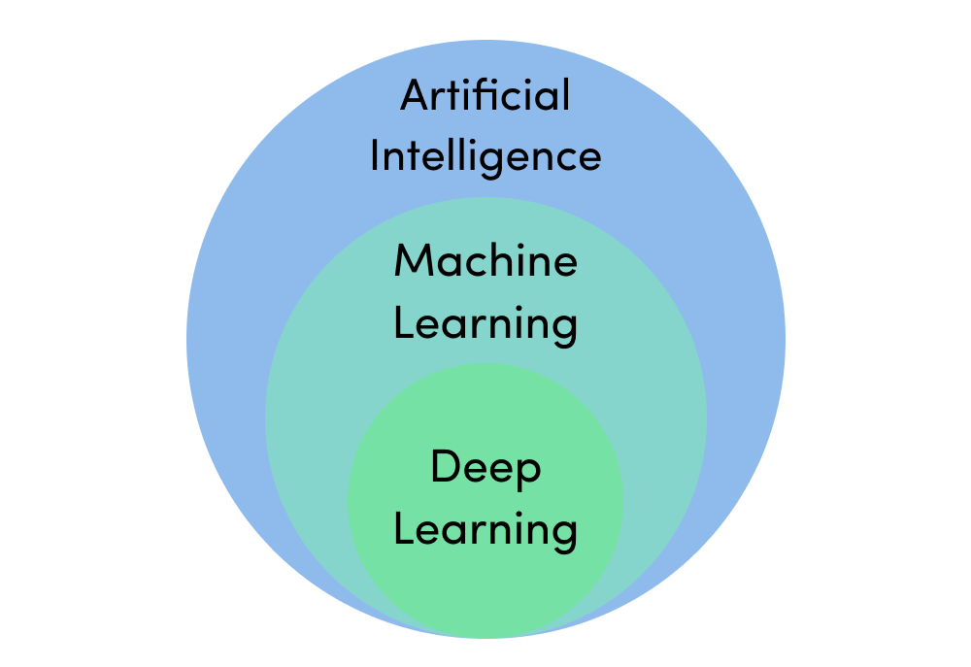
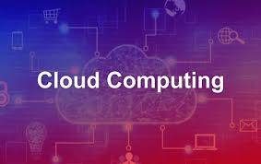
POSSIBLE APPLICATIONS
IT IS IMPORTANAT THAT THE ENTERPRISE SUBSCRIBE TO PRIVATE CLOUD COMPUTING.
EVALUATION FOR THE DATA IN THE FIRM BECOMES EASY.
BIG DATA IS MANAGED WELL.
AS IT IS A REPITITIVE TASK IT SHOULD BE AUTOMATED THROUGH MACHINE LEARNING AND DEEP LEARNING.
DELEGATION OF WORK IS Also NECESSARY

Slide 3
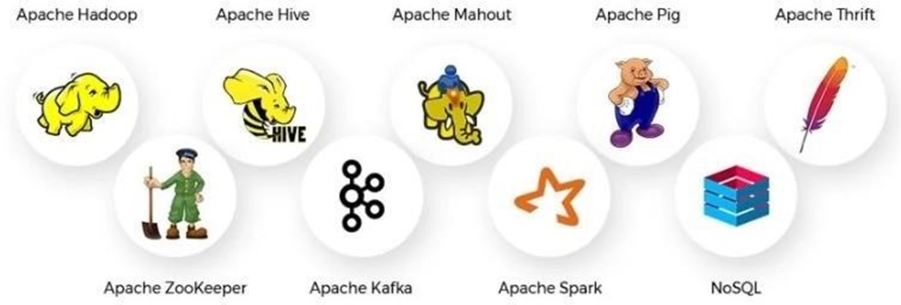
Big Data Tools and Technologies

Slide 4
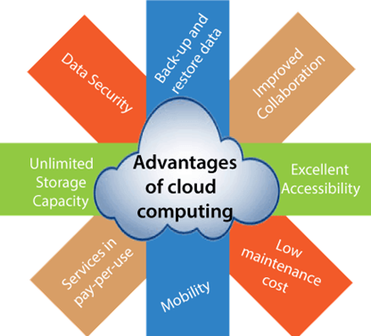
Cloud computing

Slide 5


